Slide 1
Sustainable Development Goals
Ideas for projects

Slide 2

THIMUN QATAR STUDENT AMBASSADORS

Slide 3


United Nations (http://www.globalgoals.org/#the-goals) [Public domain ή CC0], via Wikimedia Commons
GlobalGoals.org (The Global Goals Initiative) [Public domain], via Wikimedia Commons

Slide 4
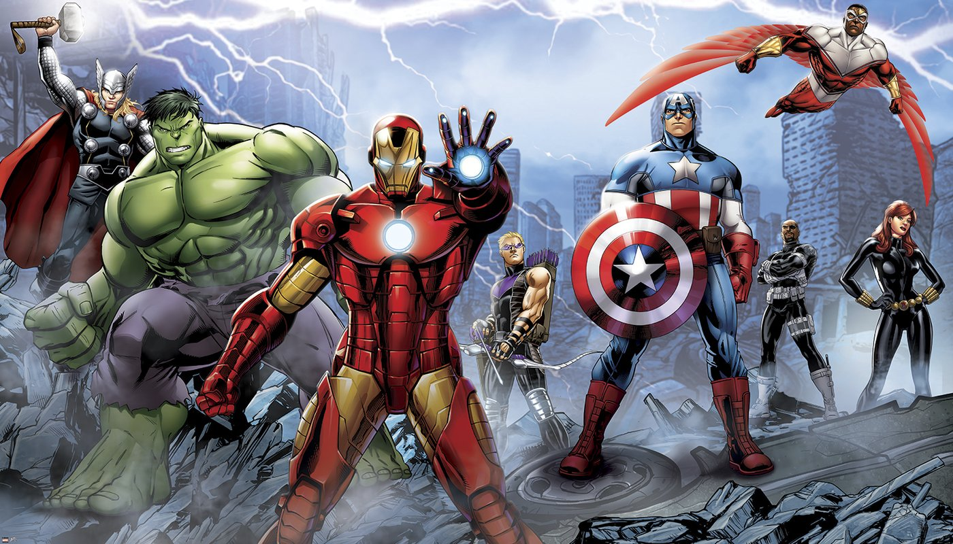
Who is your favourite superhero?
Batman? Superman? Spiderman? Wonder Woman? Iron Man?
Notes:
Why do we admire the heroes?
Purpose: to establish the fact that they could be heroes as well + SDG super heroes in their community

Slide 5
Why are they superheroes?
All of them work to make the world a better place.
What can you do to do the same?
We all work towards making a better world. We study and take care of our family to build a good future for ourselves and our families.
Superheroes build a better future for others- they work for the good of others!

Slide 6

Why do we need superheroes?
In 1961 Stan Lee created the Fantastic four comic. This was a part of an era of social change and these comics raised awareness of many social issues. They show us how to be selfless without losing ourselves and how to have hope for a better world.
Superheroes inspire us to be better ourselves!

Slide 7
Real life superheroes
Who are your real life superheroes?
In your groups- share your personal heroes.
Name
Occupation
Values they embody
Why do they inspire you personally?
What they have in common is they all work towards solving an issue
Notes:
First activity
Groups of 3

Slide 8
THIMUN Qatar student ambassador heroes
This project is about three main ideas:
  Going out into other clubs in your school, and presenting MUN Impact to them to help them link their club to the Global Goals. By spending time looking at the root causes and the SDG link, we can help those clubs to dig deeper into what they are doing and get a better understanding on their actions in a global context.
  Identifying issues that have not yet been addressed in your school, identifying the root causes and linking it to the SDGs. We can then create a project to solve this issue!
  There are many existing projects which link to the SDGs and your school can adopt some of these and support them through awareness and fundraising campaigns.

Slide 9

Notes:
20 minutes
Pick one issue ourselves – group issues

Slide 10
Linking issues to the sdgs
Example:
Issue: Parents can’t understand the internet
Go to www.MUNImpact.org and click on resources, and look at the SDG page
Which SDG connects best with this issue?
click on SDG 4: Quality Education
Click on the targets and indicators and see which target is most relevant to your issue
SDG link: 4.41 Proportion of youth and adults with information and communications technology (ICT) skills, by type of skill
Notes:
20 minutes
Pick one issue ourselves – group issues

Slide 11
New projects…what are your issues?

Slide 12
What are your issues? At home….
What issues would you like to change- find the SDG that matches them
  What issues are there in your personal life?
  Examples:
    I spend too much time playing and not enough studying SDG 4
    Spend more time with family/friends SDG 3
    My club doesn't’t have enough girls/boys SDG 5

Slide 13
What are your issues? at school…
What issues would you like to change- each issue can be matched to an SDG
  What issues are there in your school?
  Examples:
    Kids waste a lot of food at lunch SDG 2, 11, 12, 6
    Schools make too much rubbish SDG 11, 13, 14, 15
    School library is badly stocked SDG 4
    School bags are too heavy SDG 3

Slide 14
What are your issues? In your community….
What issues would you like to change- find the SDG that matches them
  What issues are there in your community?
  Examples:
    Workers can’t read and write in English SDG 4, 8
    Parents can’t understand the internet SDG 8, 9
    Cars drive too fast in the street SDG 3, 11

Slide 15
What are your Issues?
HANDOUT
Use the hand out to discuss in your groups what issues you have in:
Your Personal life?
Your School?
Your Community?
Link it to the SDGs

Slide 16
Decide on a Group issue
Type issue here…..
Notes:
20 minutes
Pick one issue ourselves

Slide 17
Identify the root cause
Discuss and identify the root cause for the group issue
Complete the circle of Whys: Why is the issue happening?
Solidify your thinking- make a sentence: this issue happens because of ……
Share your findings with the group
Example: Parents didn't have the opportunity to learn IT skills and now they feel like it’s too late

Slide 18
Imagine the possibilities
Use your handout to figure out 10 ideas of how to fix the root cause
Don’t hold back- all ideas are welcome!
  The idea should have an Impact
  The idea should be bold
  The idea should be long lasting
Discuss the ideas in your groups- write down the best idea from the group in the handout

Slide 19
Ideas for action! Be bold
Use the targets to develop a project:
  Examples:
Idea: negotiate with the school, students, parents and teachers to set up after school classes. Set up fundraising to finance the classes- sell custom T-shirts, hold a fair, stage a play and charge a fee.
Idea: research online IT classes and set up an awareness campaign detailing how to participate.

Slide 20
Project ideas- examples
Collect food and bring it to a food charity to distribute it. SDG 2
Recycle cans, bottles, paper, and newspapers throughout the school year and bring it to recycling centers. SDG 11, 13, 14
Create a simple human rights lesson and teach it to an elementary level class. SDG 4
Collectively design a T-shirt depicting your issue. Take responsibility for all aspects of the process from colors of the shirt to how much to charge. Sell T-shirts at school events and donate the money to a children’s organization. All SDGs
Make 1,000 paper cranes and take a field trip to a children’s hospital to present them. SDG 3

Slide 21
Project ideas- examples
Hold a Human Rights Reception, with projects, displays, videos, etc. for parents, other teachers, and classes. All SDGs
Create and put on a play on human rights for other classes or parents. All SDGs
Participate in a highway or park clean-up project. SDG 6, 11, 12
Research a country or specific culture. Find a contact person to interview from that country or culture, form interview questions, and report back to your class.
Set up a weighing station for food waste after lunchtime, publish the results to raise awareness of food wastage. SDG 2

Slide 22
Action!
How can we put your ideas to action?
Use the hand out to figure out what to do!
What kind of action is needed?
Which groups do you need to involve?
What is the final outcome?
When will you start and end this project?

Slide 23
Global Act with impact awards
GAIAs
5 minute max video on your service project
One project per school
December 10th 2018 deadline for submission

Slide 24
Further projects on the SDgs

Slide 25
Goal 1: No poverty
Case study: Grameen bank
Microcredit
16 Decisions
Data
Website http://www.grameen.com/
Method of action
Your ideas

Slide 26
Goal 2 Zero hunger
World food program
Data – Hunger map
Their vision: five steps to Zero Hunger
Campaign #HealthynotHungry
How can you get involved?
Website http://www1.wfp.org/
Your ideas

Slide 27
Goal 3 Good health and wellbeing
World Health organization
Health topics
No tobacco day
Leadership priorities
World antibiotic awareness week
Website http://www.who.int/en/
Your ideas

Slide 28
Goal 4 Quality education
CARE Education
The girl effect https://www.youtube.com/watch?v=QnD0Z4WJ5LA&feature=youtu.be
Steal this stats
Emergencies and action
http://www.care.org/
Your ideas

Slide 29
Goal 5 Gender equality
United Nations Population Fund
Gender equality
http://www.unfpa.org/gender-equality
Manual on social norms and change
Empower women, empower the future
Your ideas

Slide 30
Goal 6 Clean water and sanitation
Charity: water
https://www.charitywater.org/
100% of donation goes to those in need
Approach, solutions, impact
Pledge birthday
Your ideas

Slide 31
Goal 7 Affordable and clean energy
Clean energy group
http://www.cleanegroup.org/
Solar+storage=savings
Crowd-Financing Solar for Nonprofits Serving Low-Income Communities
Your ideas

Slide 32
Goal 8 Decent work and economic growth
Learn how to become
http://www.learnhowtobecome.org/make-a-difference-careers/poverty/
The poverty trap
How can you help the poor
Youth below poverty line
Your ideas

Slide 33
Goal 9 Industry, innovation and infrastructure
Umicore
Mission
Sustainability
A framework to ensure sustainable cobalt sourcing
What makes an industry sustainable?
Your ideas

Slide 34
Goal 10 Reduced inequalities
UNHCR
http://www.unhcr.org/
Figures at a glance
Emergencies
Where do they work?
What do they do?
Your ideas?

Slide 35
Goal 11 Sustainable cities and communities
Local Pathways Fellowship
http://localpathways.org/fellows/
Sustainable cities
Mission
Objectives
Meet the fellows
Your ideas

Slide 36
Goal 12 Responsible consumption and production
Global footprint network
http://www.footprintnetwork.org
Ecological footprint explorer
Overshoot day
Sustainability index
Country work
Your ideas

Slide 37
Goal 13 Climate action
Climate action programme
http://www.climateactionprogramme.org/
Paris agreement
Carbon pricing
Green innovation
Policy
Your ideas

Slide 38
Goal 14 Life below water
Sea change project
http://www.seachangeproject.eu/
World ocean day
Ocean literacy
Marine litter
Make the pledge
Your ideas

Slide 39
Goal 15 Life on land
Conservation International
Experience the Amazon in VR
A bold plan to protect Amazonia
Nature is speaking
Science + Innovation
http://www.conservation.org
Your ideas

Slide 40
Goal 16 Peace justice and strong institutions
PeaceJam
Unleash your potential
Conferences
Do a project
Nobel prizes
Your ideas
http://www.peacejam.org/

Slide 41
Goal 17 Partnership for the goals
Global partnership for sustainable development data
http://www.data4sdgs.org/
12 Key plans
Data in action
Data on the 17 goals http://saplumira.com/unglobalgoals/
Your ideas

